Slide 1
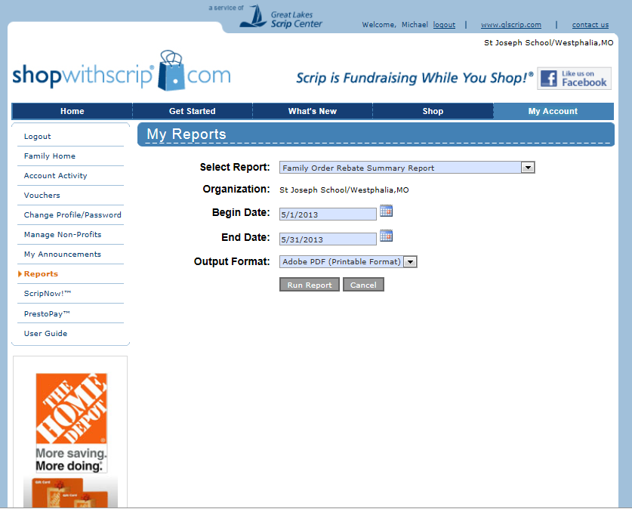
How to track your Scrip Credits Earned
Log on to www.shopwithscrip.com
Select Reports from the left hand side of the screen
The beginning date is 5/1/2013 for the 2014-15 school year credits to be earned
(the fiscal year for scrip ends 4/30/14)
There are 3 reports to choose from, all will give you the scrip credit earned
Detail Report list each individual card
History Report list each order total
Rebate Summary list the total rebate earned to date

