Slide 1
ScripNow! Get your Scrip-NOW!
ScripNow! is a electronic form of scrip. You can print it out right from home, within minutes. If you use PrestoPay, you’ll have your scrip in a few minutes. If you choose to pay by check you’ll need to text/email Stacey Rademan to release it, which may delay the process a bit depending on my availability.

Slide 2
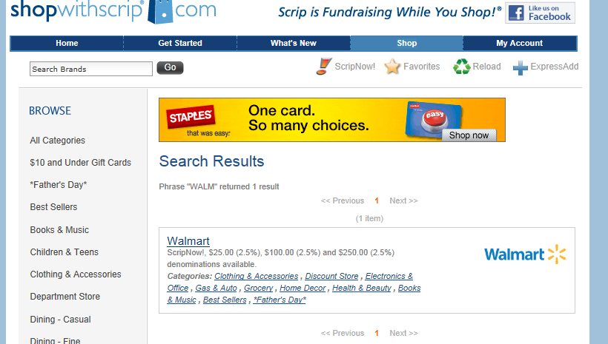
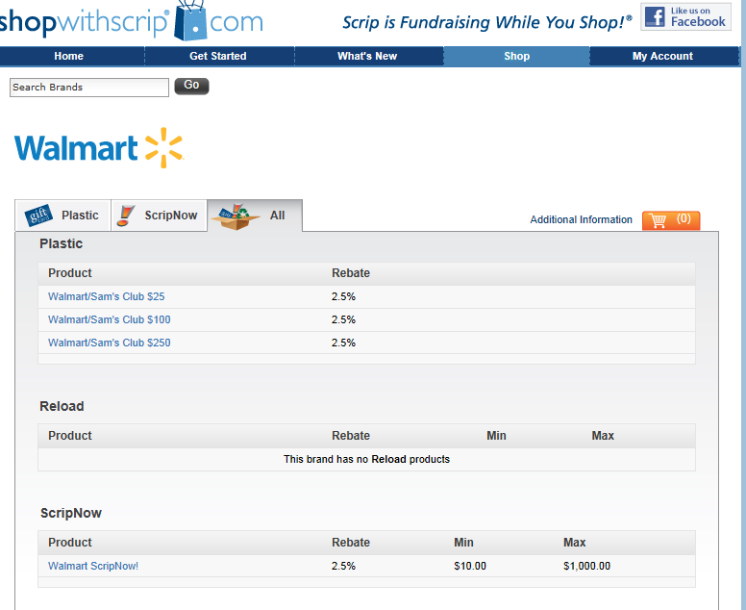
Go to www.shopwithscrip.com
You can click on the ScripNow button and all of the retailers available in this format will come up.
Once you choose one, the card will come up with all of the options its available in. Some are available in Plastic, ScripNow, Reload and/or All of the above, it just depends on the retailer as to which format/s they are available in.
Select the ScripNow version of the card if you are wanting to print it out.

Slide 3
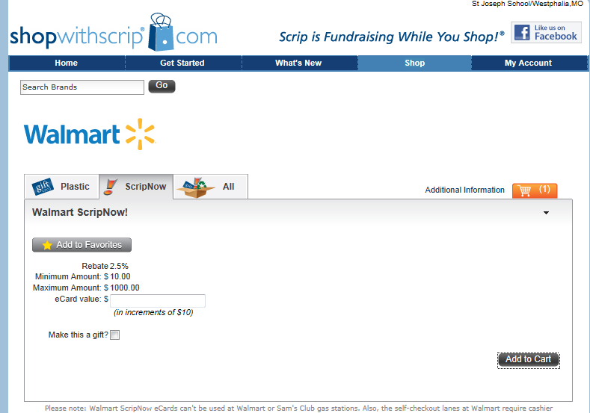
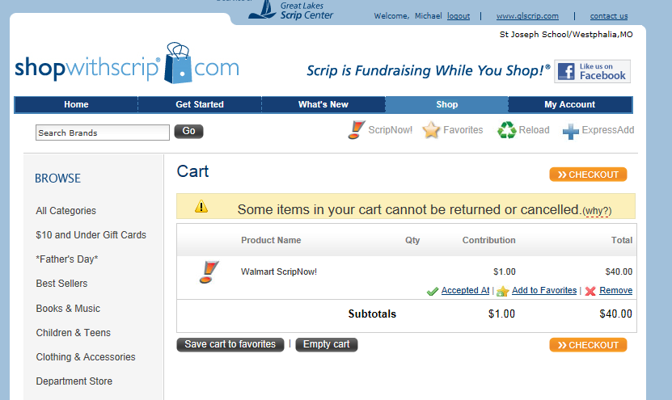
Now to purchase your ScripNow! Cards
Enter the amount in denominations of $10, some cards require different amounts, into the eCard Value box
Select Add to Cart
The page won’t close but you’ll notice a increase in your cart
Click on the Cart when your ready to order and you will be taken to the Checkout

Slide 4
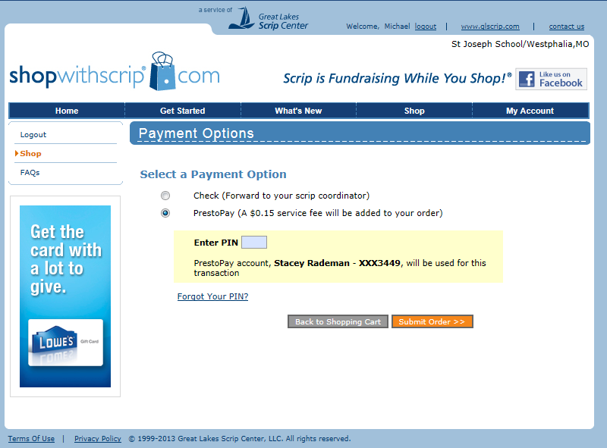
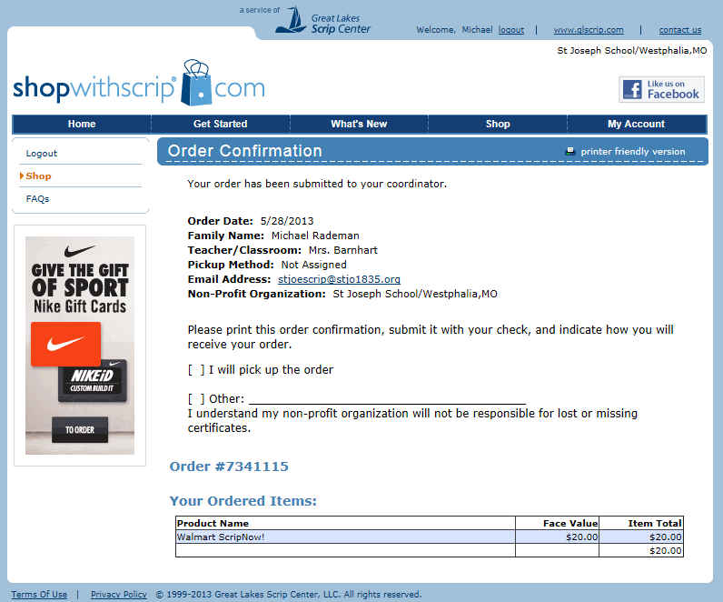
Time to Pay, Check or ACH (Presto Pay)?
Once your ready to pay, if you’ve signed up for PrestoPay, you will have the option of pay by Check or PrestoPay
If you have not previously signed up for PrestoPay, which takes 2 days to set up, you will not have this option
If you select PrestoPay, you will receive your scrip within minutes. This is the preferred method when using ScripNow!
If you select check, you will need to text or email Stacey Rademan to have her release your order
Once you’ve paid you will receive a confirmation page

Slide 5
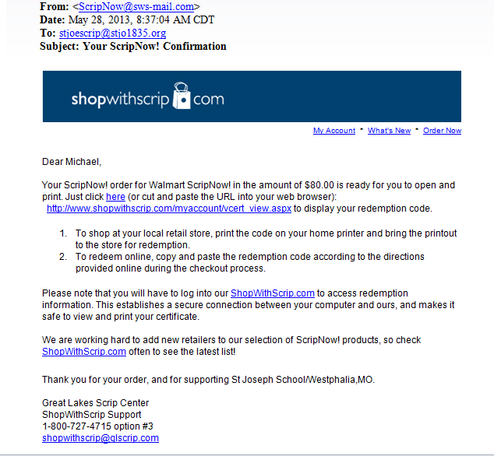
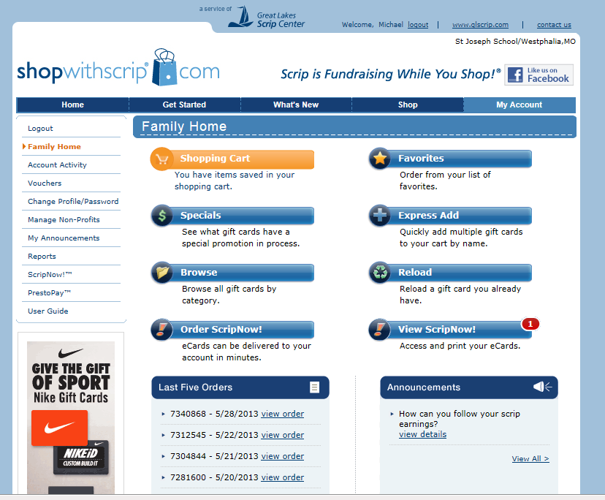
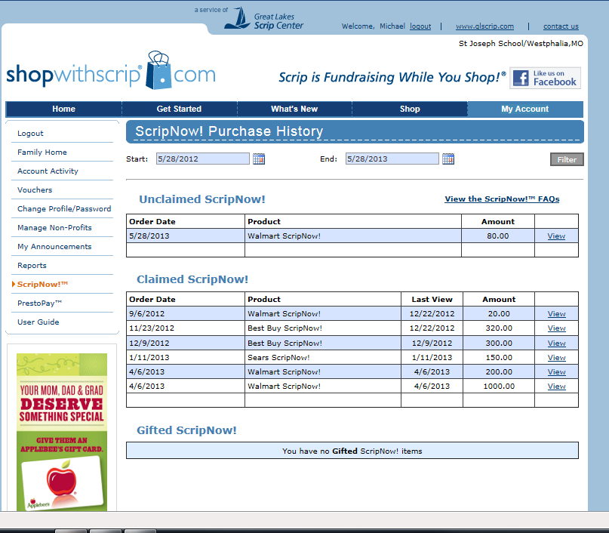
When will my ScripNow! be ready?
You’ll know your order is ready to be printed once you see a
to the right of your ‘View ScripNow!’
section on your ShopWithScrip
home page
You will also receive a email when your scrip is ready to be print
You can view past ScripNow purchases for years past, whether there is a balance left or not
1

Slide 6
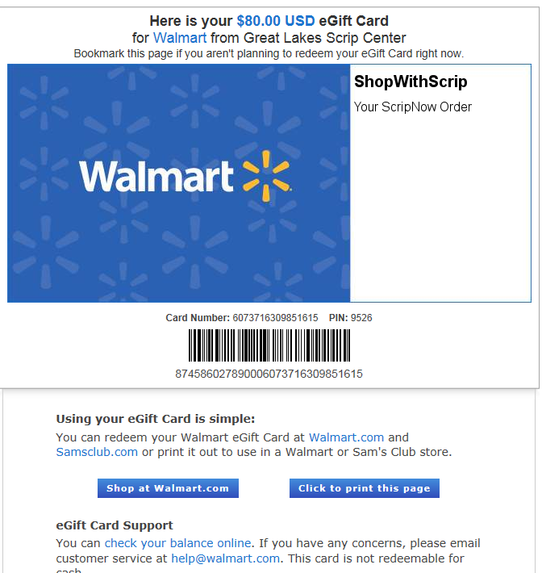
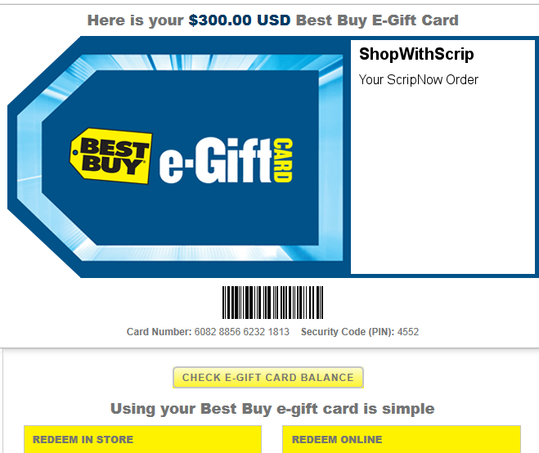
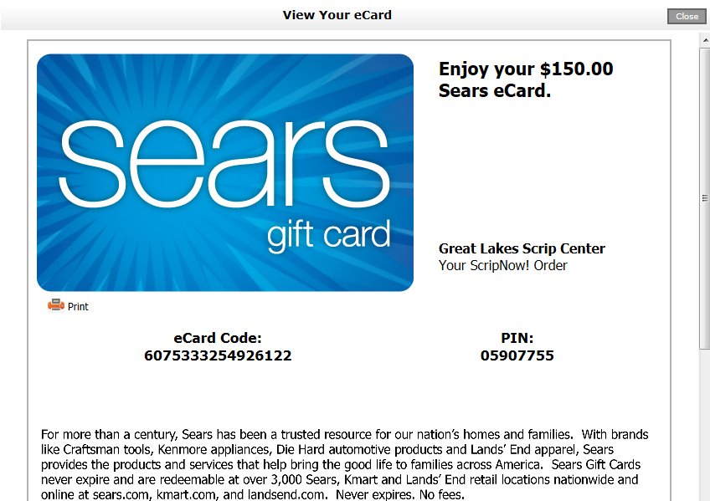
What will my scrip look like?
Each card will look different, but close to the typical scrip plastic card purchased
You can use these ‘cards’ at the store or online
Some retailers such as Lowe’s, Best Buy, Staples and Home Depot will scan the card from your phone. At this time Wal-Mart does NOT
Please let Stacey know of additional retailers that will scan these from your phone

